Slide 1
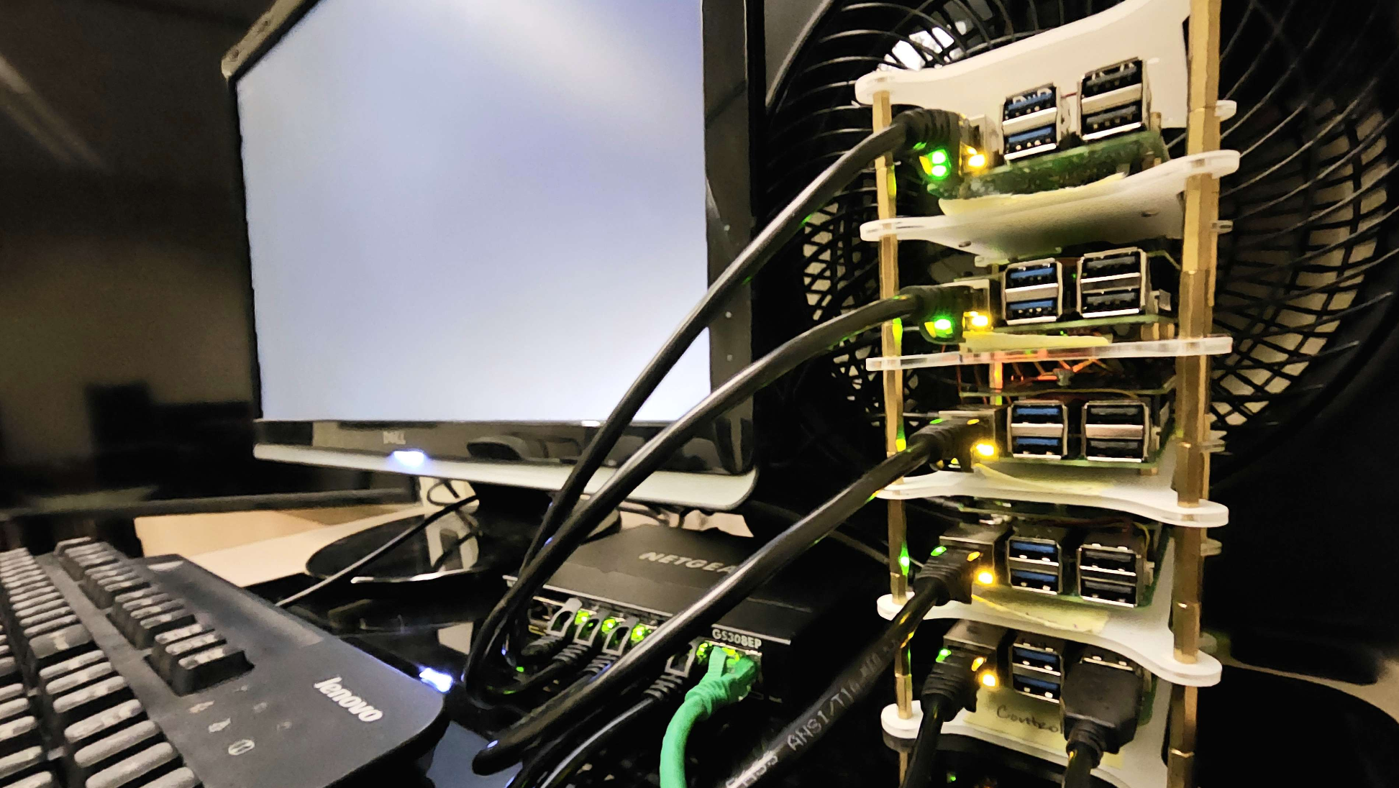
ClusterGit
Team #12:
Conner | Lauren | Sasha | Sean | Brandon

Slide 2

What to Expect
Problem To Solve
Goals to Achieve
Big Picture
Demo!
Future Plans

Slide 3
Problem
To Solve

Slide 4



Problem Statement
Large files unsupported by popular version control software
Difficult to make larger projects
Github file size limit is only 100mb
Game development course
Notes:
Sasha

Slide 5
GOALS

Slide 6


Semester One
Semester 2
Configure and ensure reliability of server infrastructure.
Develop web application to ease access to the storage solution.
Notes:
Sasha

Slide 7
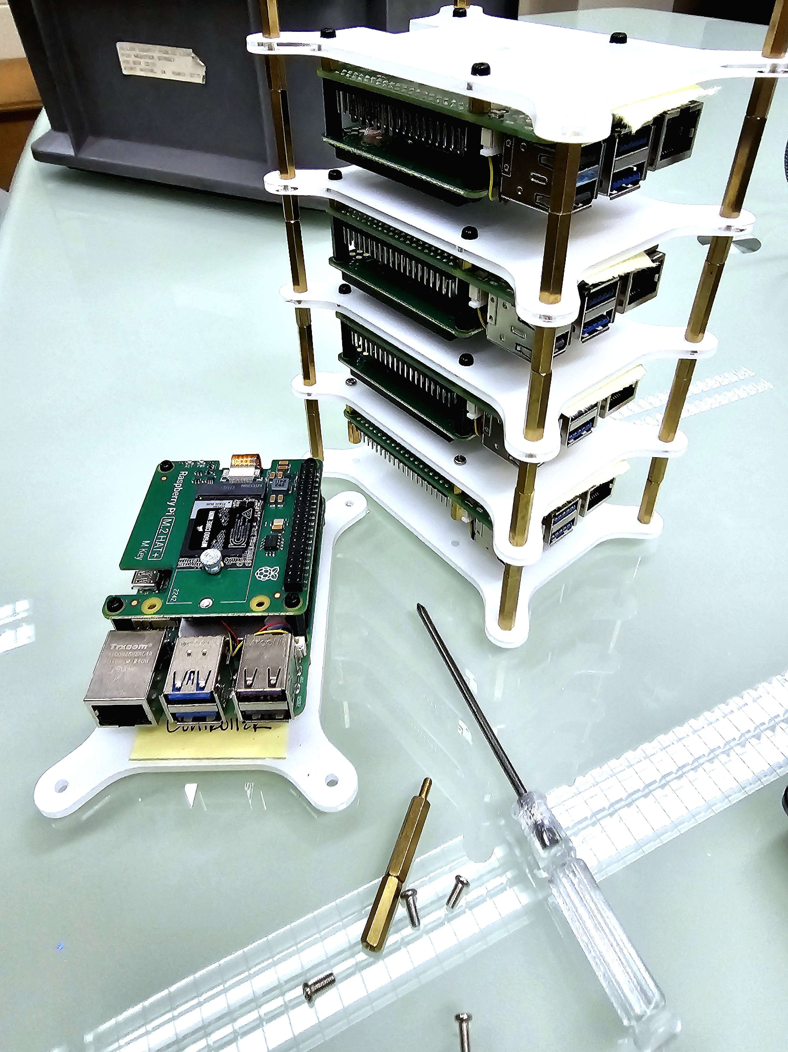
So far…
Clusterization of Pi’s together
Persistent storage across the cluster
Database designed and implemented
Monitoring dashboard
Notes:
Brandon

Slide 8
THE BIG PICTURE

Slide 9

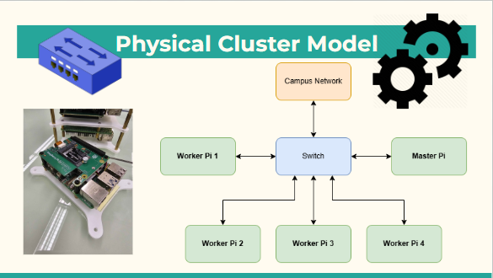

Slide 10
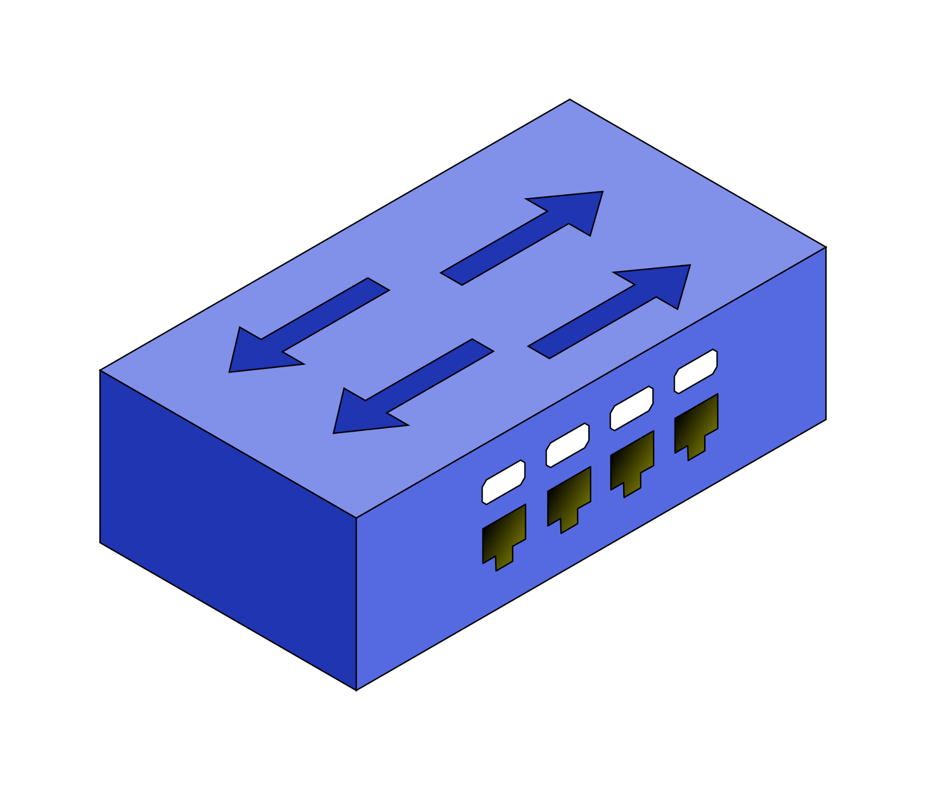
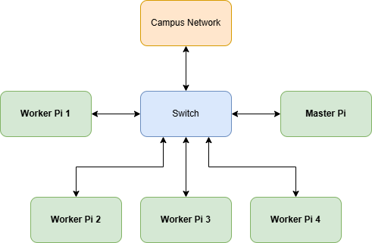
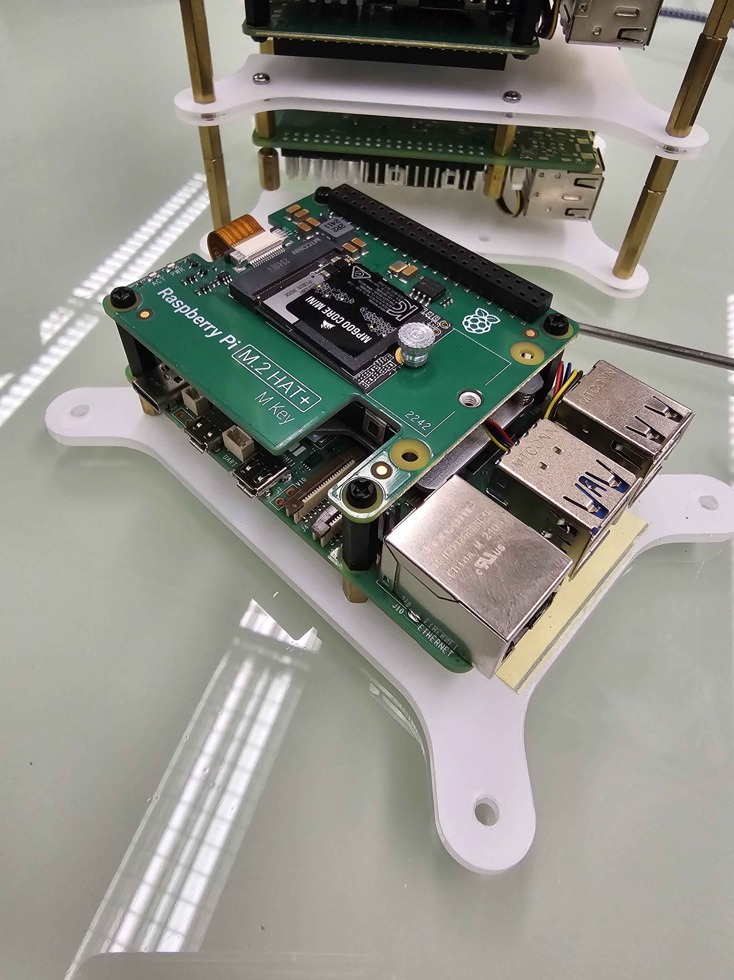
Physical Cluster Model
Notes:
Sean

Slide 11


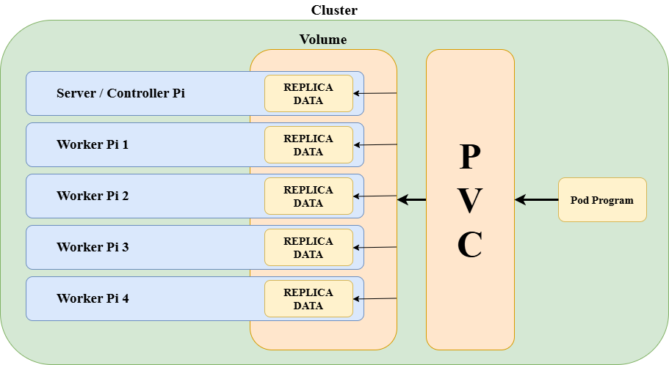
Internal Cluster Model
Logical ClusterGit Model
Notes:
Sean
What to show, I want to show the user forming a connection to the cluster and then inside the cluster the pod with the repos (software architecture diagram???)
((good place to explain why/how differs to github. For instance annex pointing to storage on hardware, ect))

Slide 12
DEMO
Recorded Workflow

Slide 13
FUTURE OF CLUSTERGIT

Slide 14
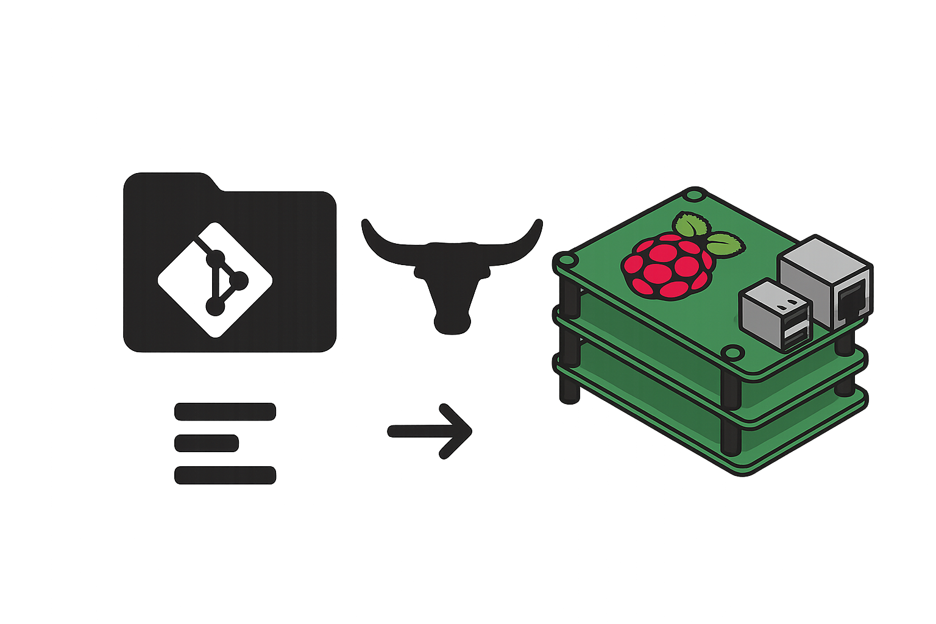
Next Semester Plans
Web-UI Integration (Honors Student)
Fully Integrated Database & User Authentication
Full User Functionality
User Testing
Notes:
Conner - i am currently working on the backend supabase database that we will be utilizign

Slide 15
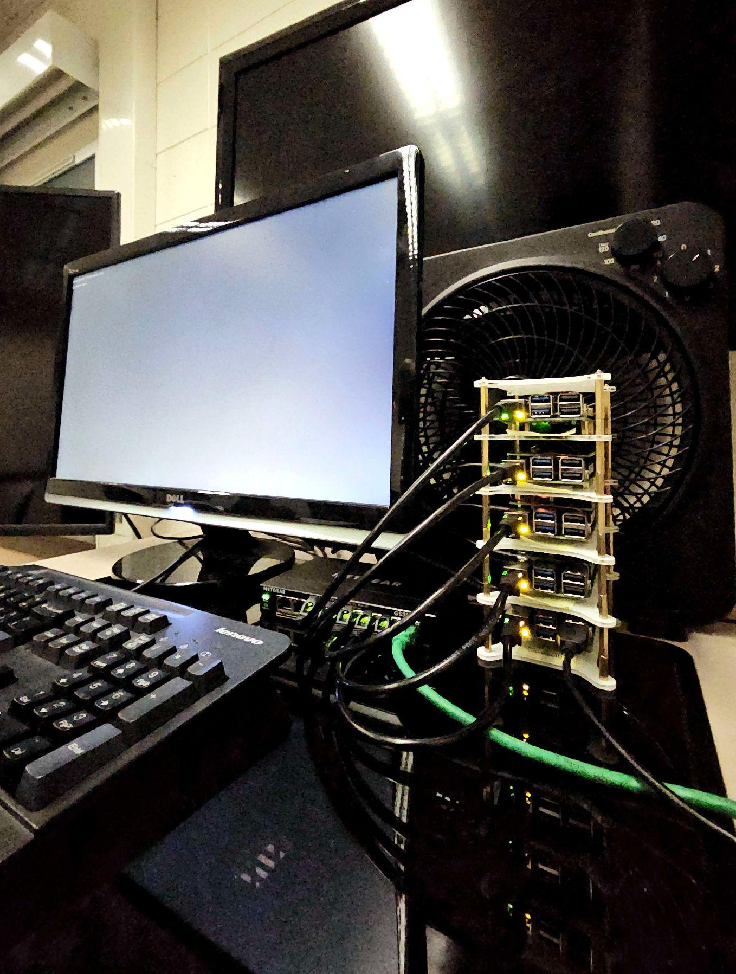

What We Covered
Problem To Solve
Goals to Achieve
Big Picture
Demo!
Future Plans
Notes:
Conner - Large Game files, faculty student admin use cases, hardware failure, we built the cluster, System models, and next steps

Slide 16
THE END

Slide 17

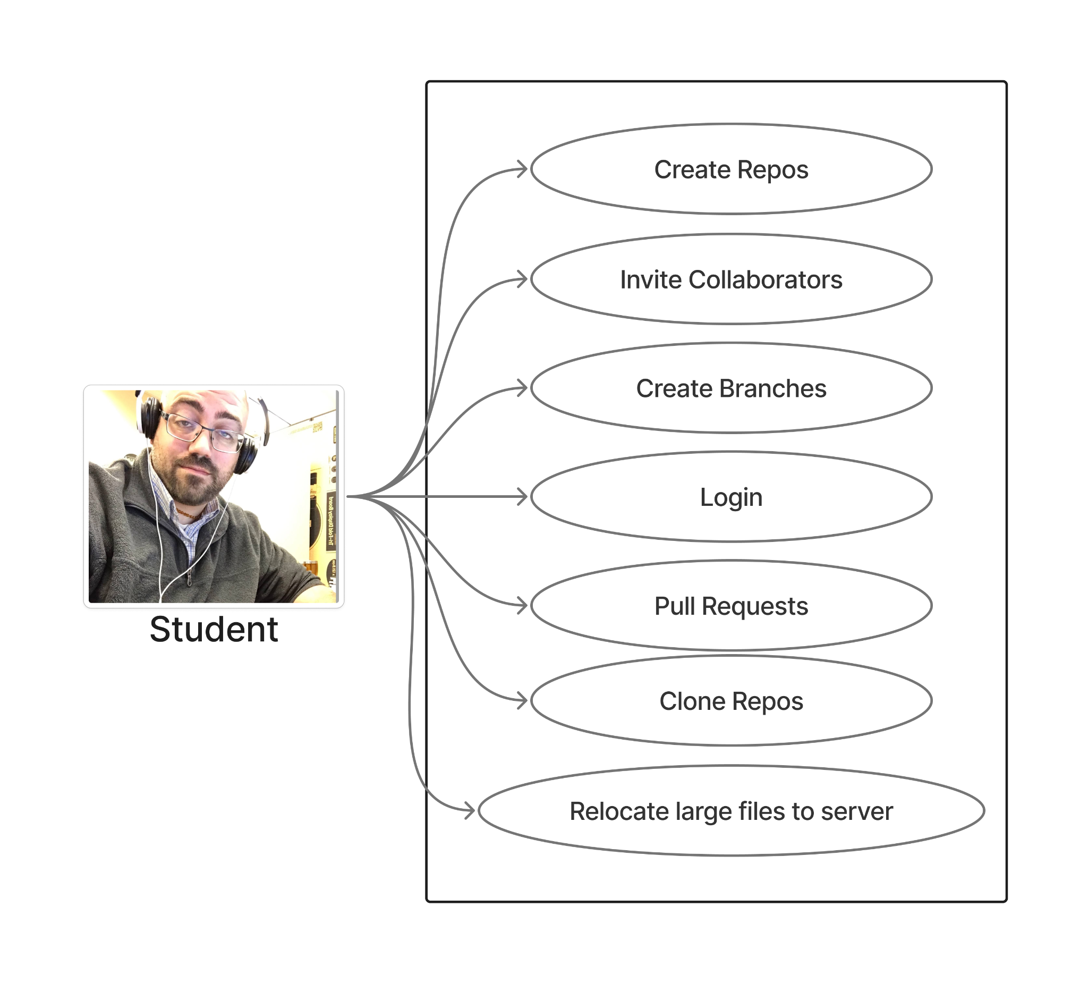
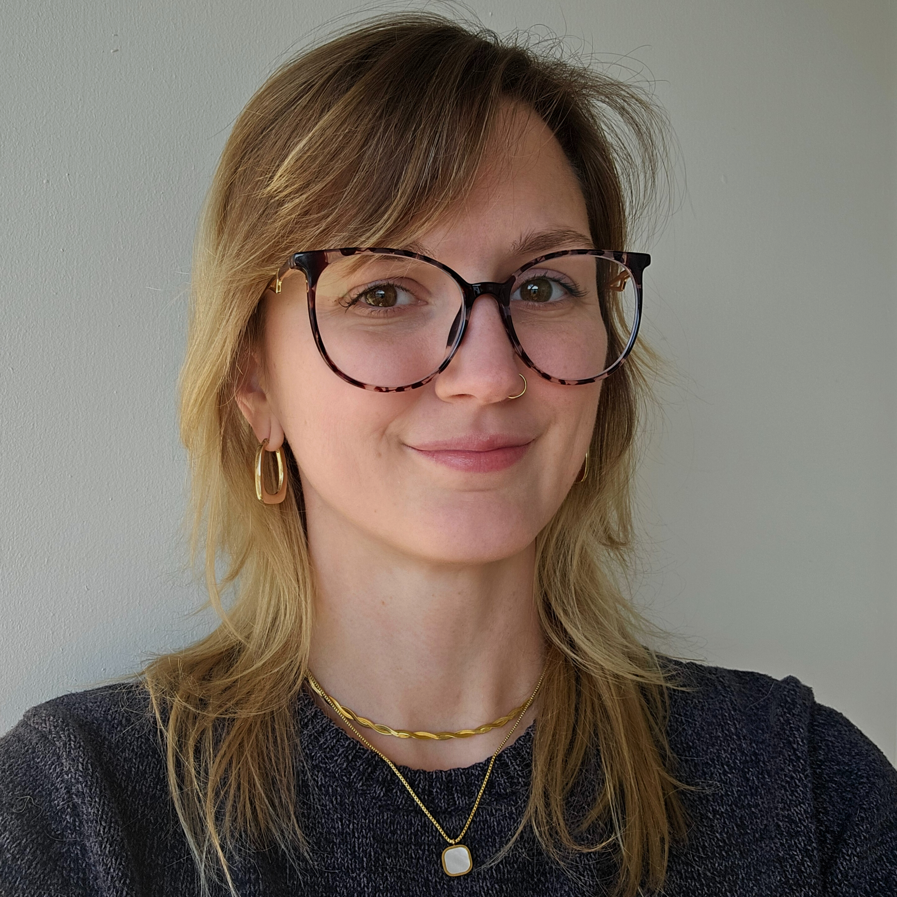
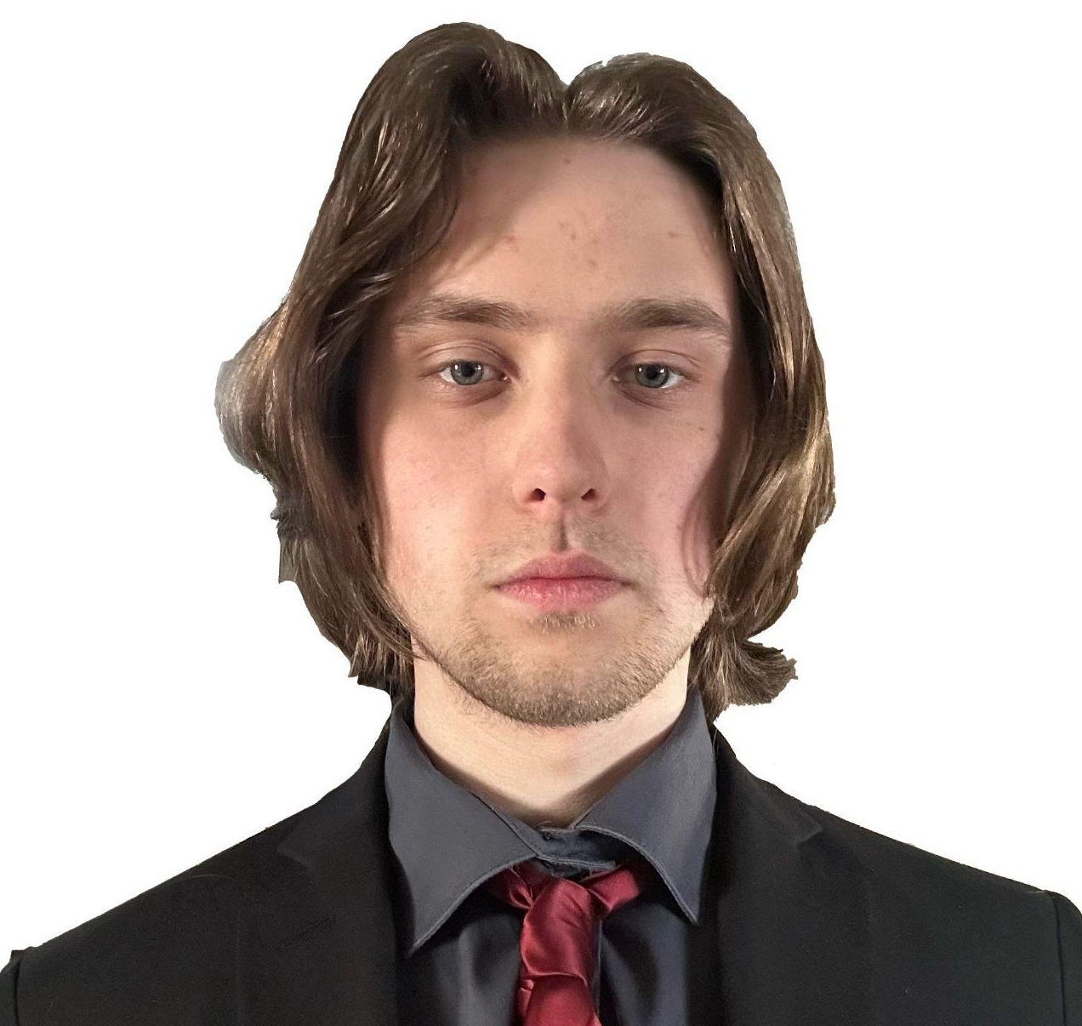
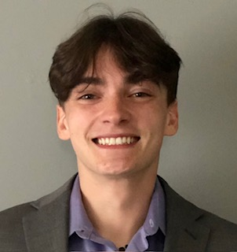
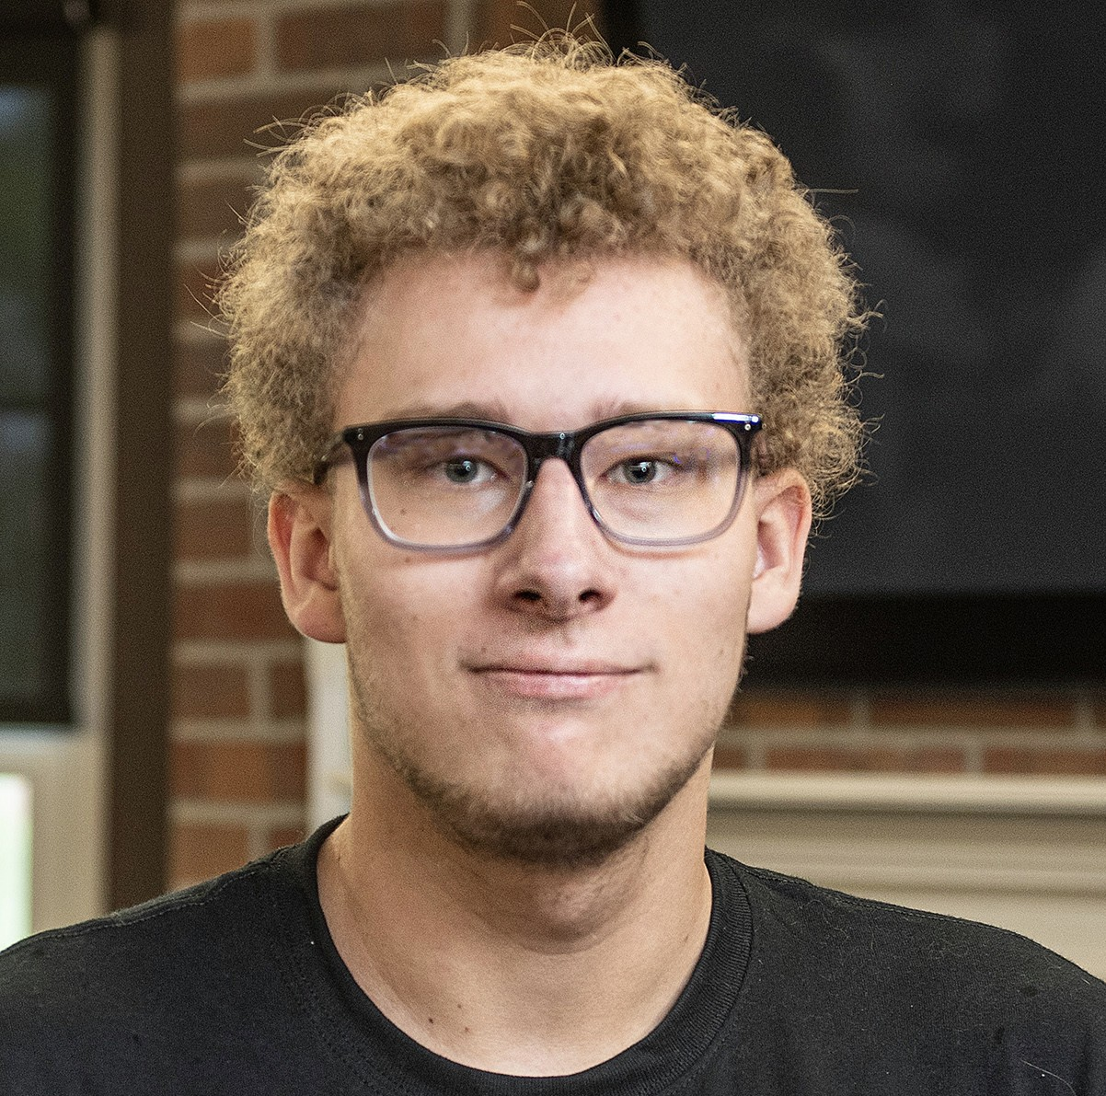
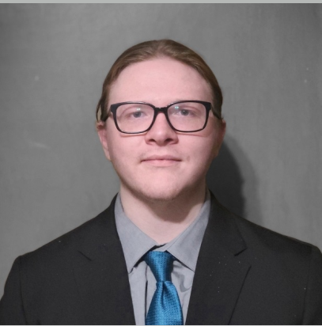
THANK YOU! Questions?
<- Jay Johns
Faculty Advisor
Lauren Sasha Conner Sean Brandon
Infrastructure Engineer & Team Lead
DevOps Engineer
Backend Systems Engineer
Storage & Reliability Engineer
Backend Systems Engineer
Contact:
teamclustergit@gmail.com
See you next Semester!!!
Notes:
Conner

